Slide 1
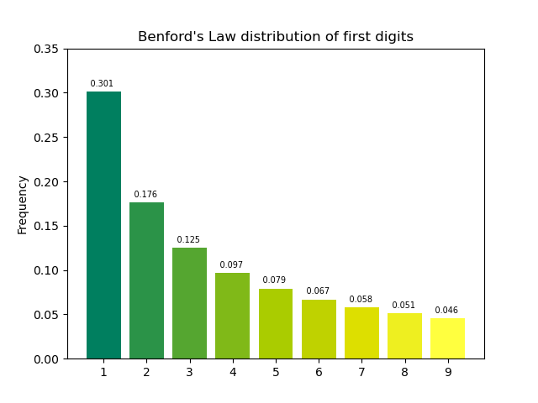
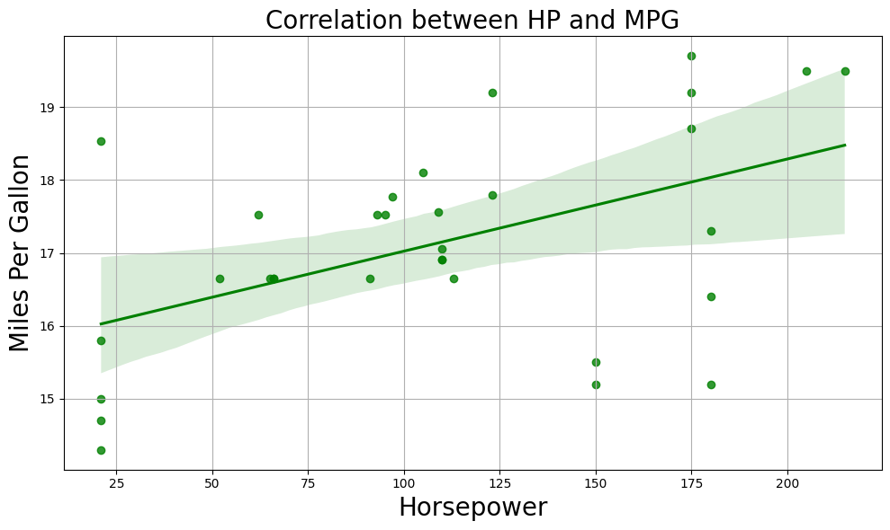
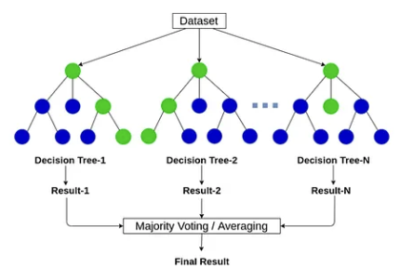
Detection of Correlation Reversal Manipulation
via Benford’s Law and Random Forest
Benford’s Law
(Statistical Analysis)
Random Forest
(Machine Learning)
Detect
Data Manipulation
Correlation Reversal

Slide 2
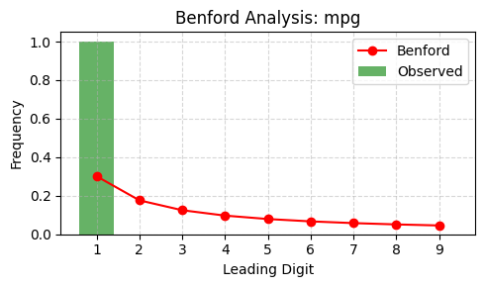
Detect Manipulation using Benford’s Law
Chi-square = 74.3017, p-value = 0.0000000000006
Criteria: Chi-square > 30.58 and p < 0.0001
Classified as Banford Anomaly and extreme

Slide 3
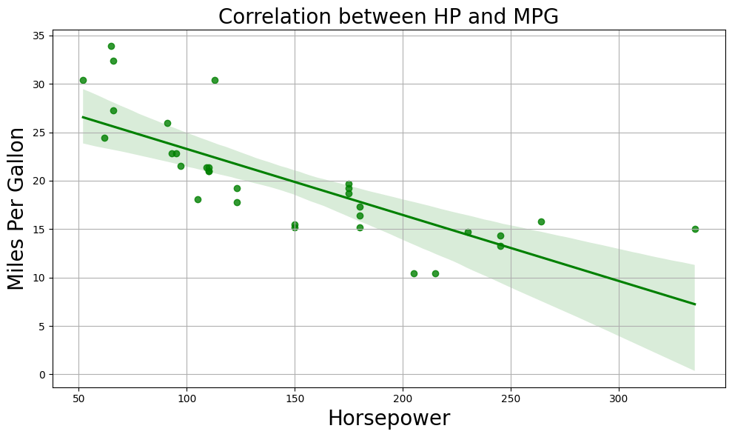
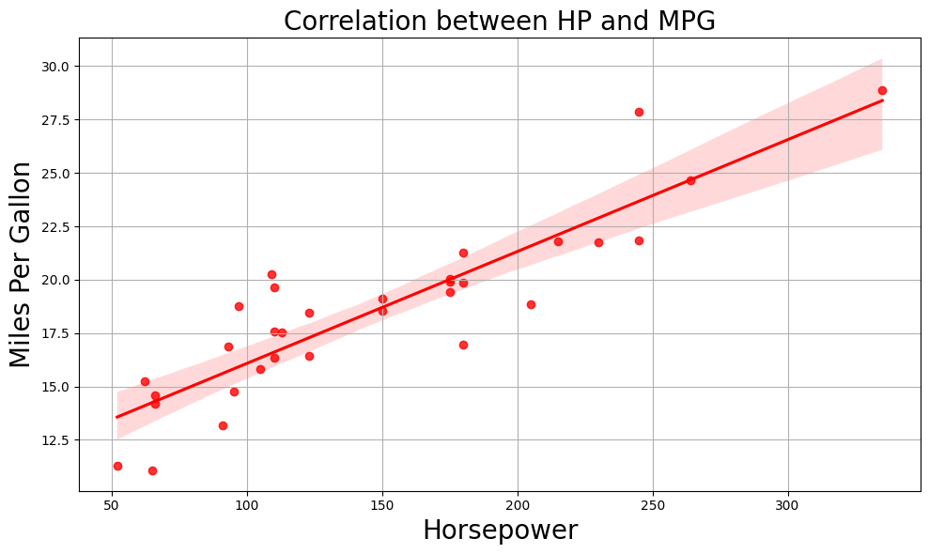
Detect Manipulation using Random Forest
Original Data (Label=0)
Supervised Training
RF Model
Manipulated Data (Label=1)
New Manipulated Data
Classification
RF Model
As manipulated

Slide 4
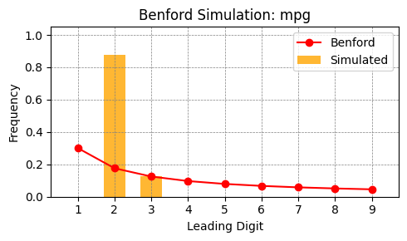
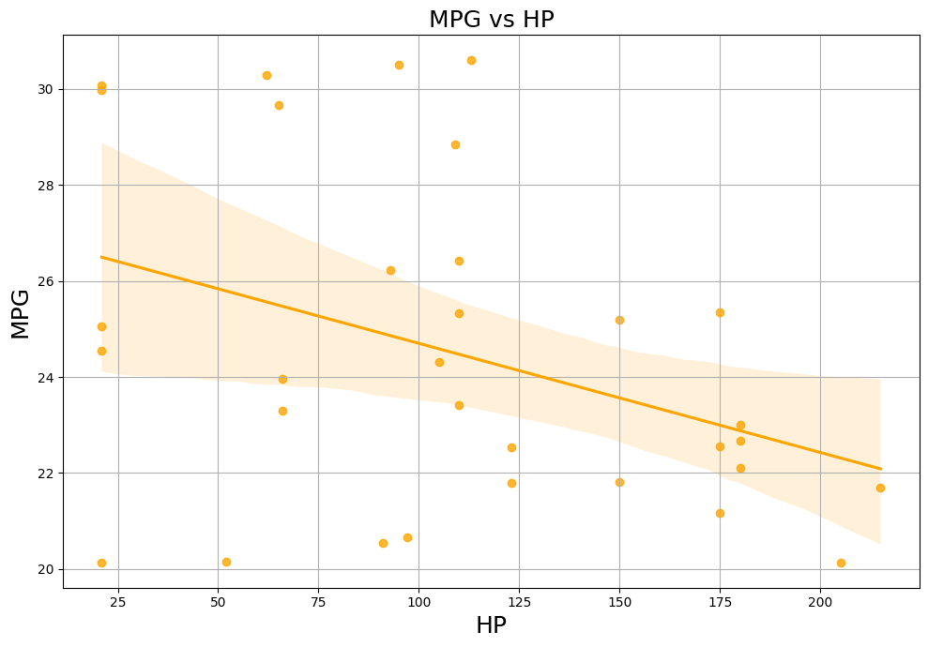
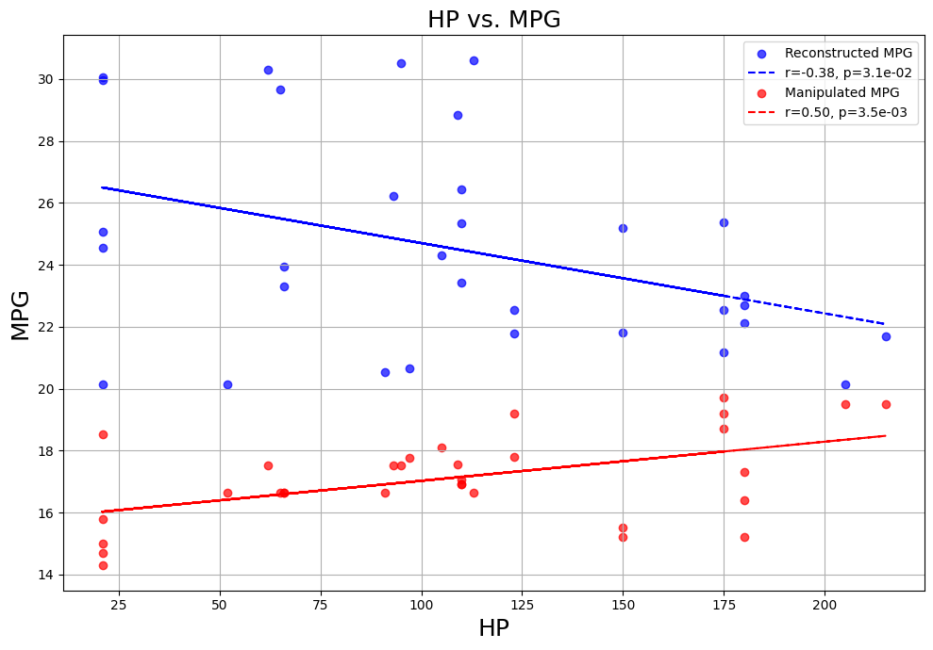
Detect Correlation Reversal using Benford’s Law
Stochastic Simulation
Reconstructed Data

Slide 5
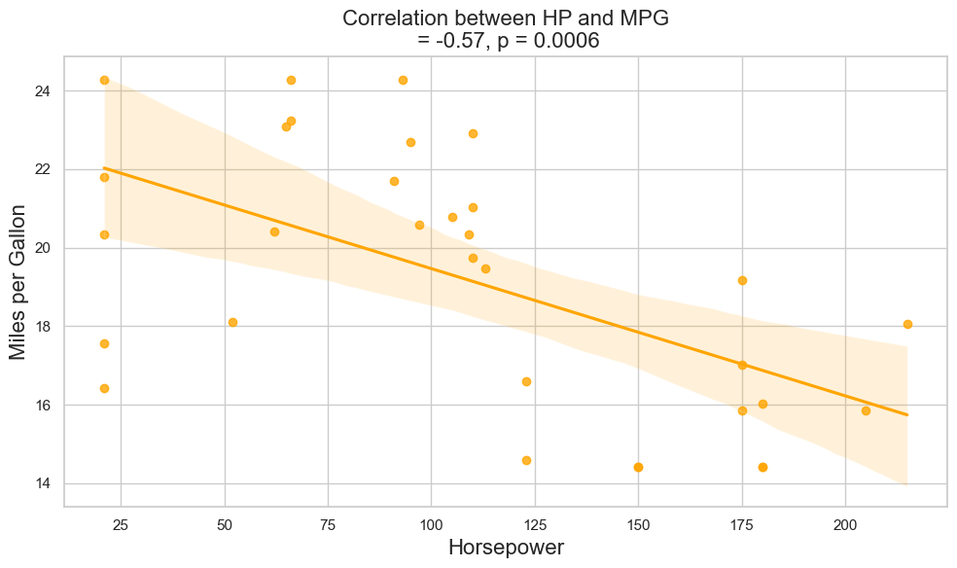
Detect Correlation Reversal using Random Forest
Original Data
Training
RF Model
Manipulated Data
Reconstructed Data
Regression
RF Model

Slide 6
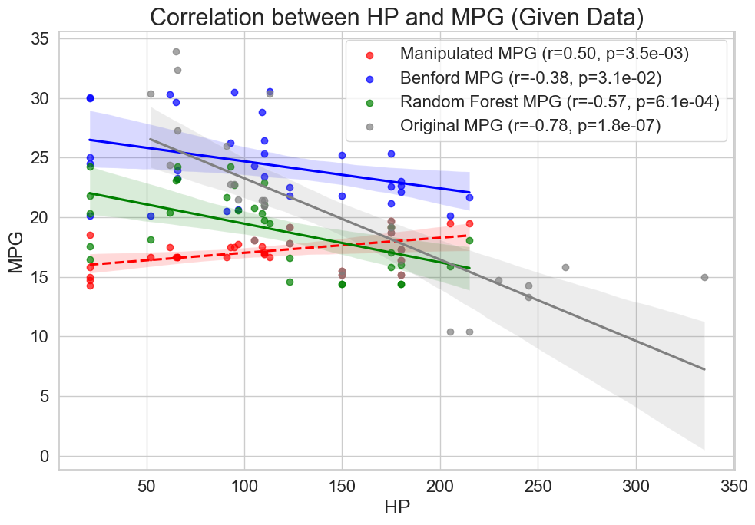

Slide 7
